Slide 1


BLOCKCHAIN IN HEALTHCARE MARKET
PROOF OF CONCEPT, SCOPE and much more

Slide 2
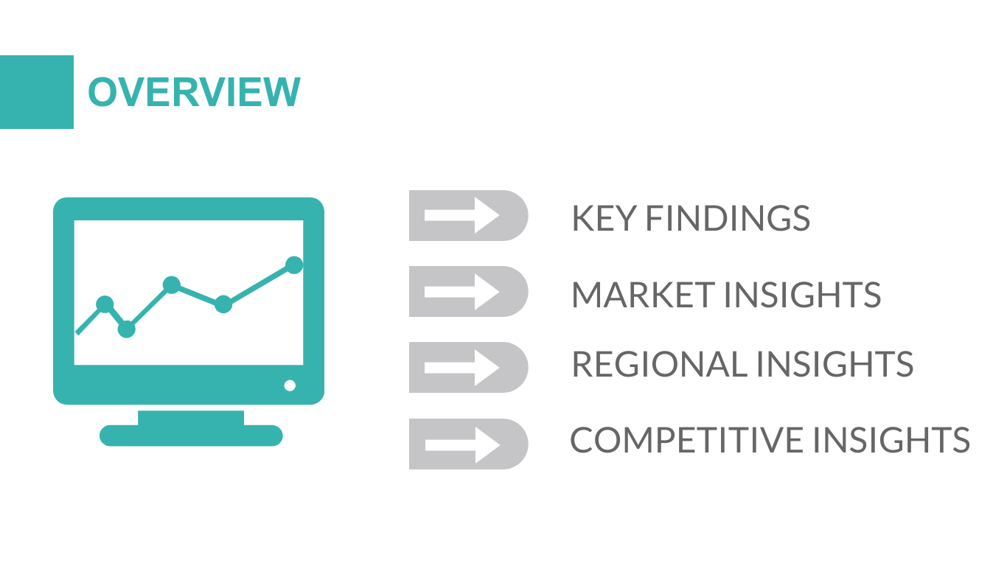

KEY FINDINGS
MARKET INSIGHTS
PROOF OF CONCEPT
FUTURE SCOPE

Slide 3
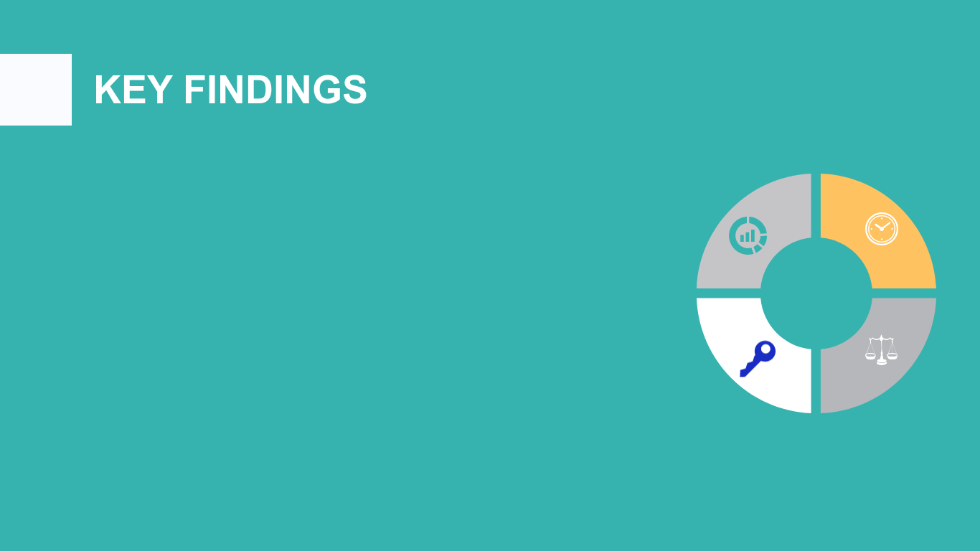

Blockchains will do for networks of enterprises and business ecosystems what enterprise resource planning (ERP) did for the single company.
Global blockchain in the healthcare market is assessed to grow with 47.23% CAGR during the forecast years of 2019- 2027.
The fact that there is not only transparency upon this technology’s usage, but also solid protection against cyber attacks are pushing the adoption of the blockchain technology in the healthcare sector and also data integrity, ease of use and feasibility.

Slide 4
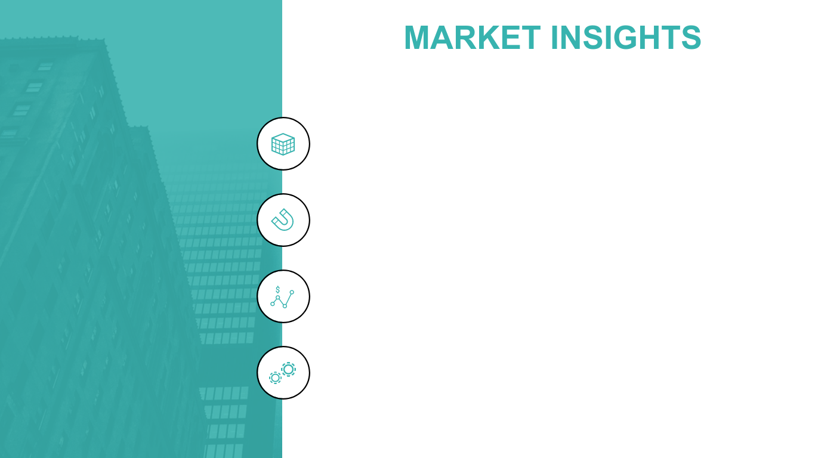
There are many prominent investors and investees in blockchain technology that is aiding the growth of the global healthcare blockchain market since the knowledge of the benefits and power of blockchain are being understood by various entrepreneurs.
Blockchain within the healthcare industry will encompass humongous data of medical records, images, documents, respective transaction details and lab reports which require a significant amount of storage space, for which every member included in the chain must regularly invest for the exceeding storage capacity.
The global blockchain in the healthcare market is segmented by organization size, blockchain type and application. The use case POC presented here is a Private Blockchain aimed at storing Patient Data in a secure, immutable and decentralized manner.
Sourced from EY FICCI report Re-engineering Indian Healthcare 2.0:
61% patients surveyed in 2019 believe that hospitals did not act in their best interests, as against 37% patients in 2016
63% patients indicated that they were not happy with hospital responsiveness and waiting times
59% patients felt that hospitals are not concerned about feedback and do not actively seek it

Slide 5
Healthcare Challenges addressed by Blockchain
Manual processes
A great number of processes are still in paper form, opening the door to unnecessary operational risks.
.
Lack of transparency
The mixture of manual, siloed systems and disorganized data creates databases with few actionable insights and creates analysis paralysis.
.
Cybersecurity risk
Legacy systems give rise to cybersecurity risk as a result of segmented IT infrastructure. A hack into just one back door can compromise the whole organization.

Slide 6
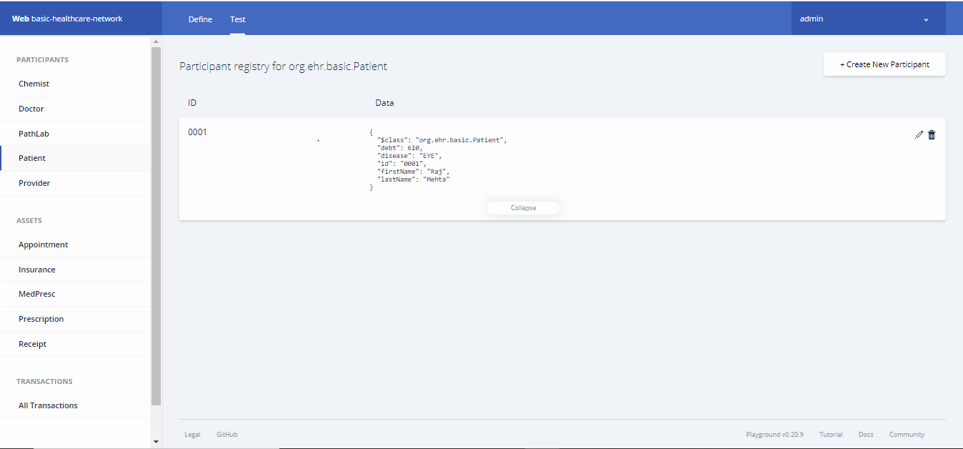
Healthcare Records Management POC
The following Network was built using a popular Blockchain Tool and JavaScript –
HYPERLEDGER COMPOSER
It is a single Network Solution to –
Book Appointments with Doctors at Hospitals in Public/Private Networks.
Doctors can Confirm Appointment and upload Medical Prescriptions/Instructions for medicines/tests.
Post Consultation, patients can buy medicines from Chemists on the network.
Post consultation, patients can buy Test from the Pathology labs on the Network.
Moreover Insurance Providers are READ – only participants of this network to access service data provided to their clients (Health Records).
Receipts of treatments are stored on a blockchain and automatically available to insurance providers as proof-of-delivery. The ledger, too, could be used for general healthcare management, such as supervising drugs, regulation compliance, testing results, and managing healthcare supplies.

Slide 7
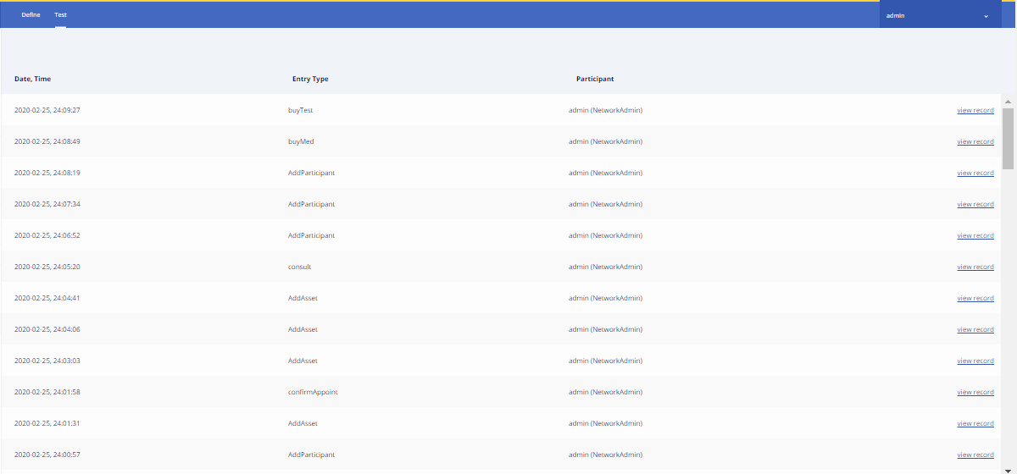

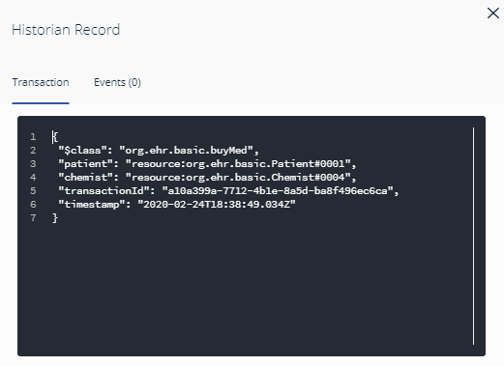
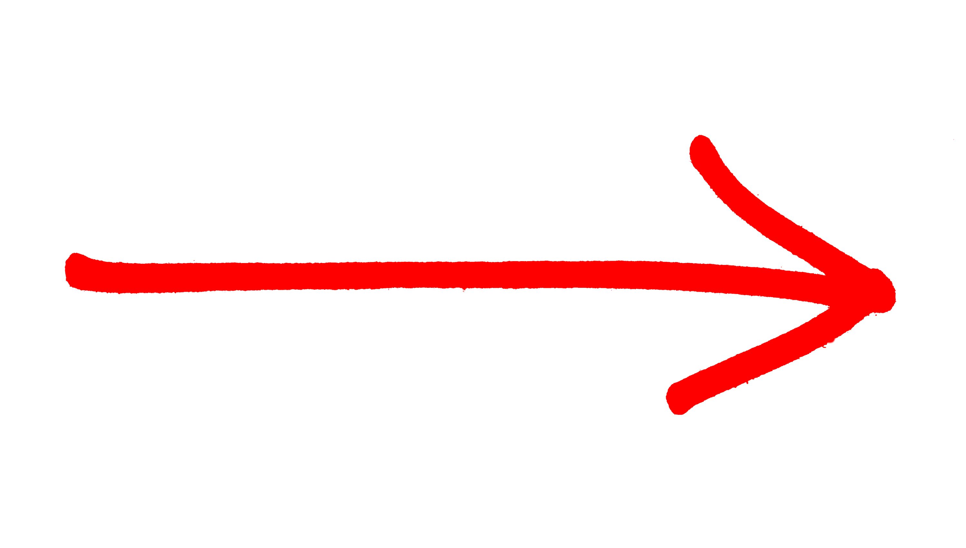
Transaction Records
Timestamps for all changes made in the network
Hashed transaction ID for maximum security

Slide 8
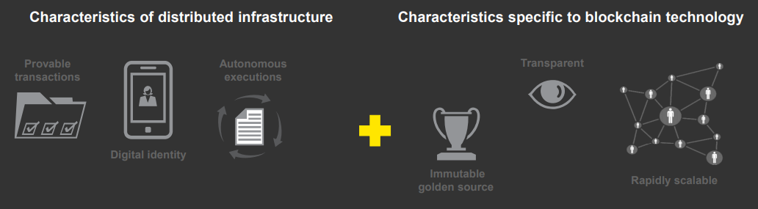
Scope of Blockchain
Blockchain technologies enable storage of data at the record level (transaction) in an immutable shared database, while allowing users to access and validate data with minimal effort.
Distributed infrastructure is technology that allows the distribution of trusted value transfer and execution — the disintermediation of intermediaries — when the network becomes the intermediary.
This study SOLELY FOCUSED ON HEALTHCARE RECORDS MANAGEMENT and not associated BILLING AND ORDERS TRANSACTIONS through Smart Contracts.

Slide 9
User Application
The peer to peer network is accessed through an application on mobile or other devices to store transactions in the permissioned ledger and access all Healthcare records in a transparent, immutable, decentralized and easy manner
Application for Pathlabs
Application for Patients
Application for Doctors
To conduct Tests and
share related detail with concerned
Authorities.
Create Accounts, book appointments
make transactions and track Health Data
Confirm Appointments with Patients
and share information with separate
Departments.
Application for Chemists
Application for Insurance Provider
Hospital Network Administrator
To issue medicines and share related
Details with concerned authorities.
Track Health care records and access
Insurance Provision data.
Deploy the Blockchain network and
Design access frameworks for each person
as per legal structures.

